Slide 1
Digital System
Chapter IV.
Combinational Logic
고려대학교
전기전자전파공학부
최 린

Slide 2

Combinational vs. Sequential Circuits
Combinational circuits
  Outputs are determined by the present inputs
  Can be specified by a truth table that lists the output values or by a set of m Boolean functions, one for each output variable
Sequential circuits
  Logic gates + storage elements (called flip-flops)
  Outputs are a function of the inputs & states of the storage elements (state of storage elements is a function of previous inputs)
  Output depends on the values of present & past inputs
Notes:
4

Slide 3

Analysis Procedure
Determining the function that the circuit implements
  1) Make sure that the circuit is combinational, not sequential
    No feedback or storage elements
  2) Obtain the output Boolean functions or the truth table
    Interpret the operation of the circuit
Derivation of Boolean functions
  To obtain the output Boolean functions from a logic diagram
    1) Label all gate outputs that are a function of input variables; Determine the Boolean functions for each gate output
    2) Label the gates that are a function of input variables and previously labeled gates; Find Boolean functions for these gates
    3) Repeat (2) until the outputs of the circuits are obtained in terms of the input variables
Derivation of the Truth Table
  The derivation of the truth table for a combinational circuit is a straightforward process once the output Boolean functions are known.

Slide 4
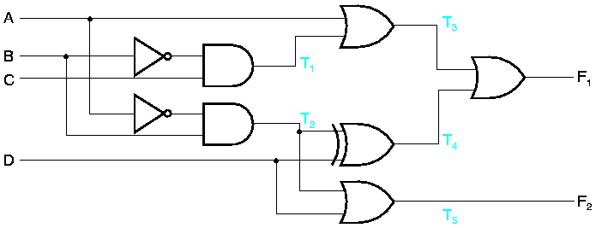
Analysis Procedure
Ex)
  4 inputs, A, B, C, D; 2 outputs, F₁, F₂
  T₁ = B' C; T₂ = A' B
  T₃ = A + T₁ = A + B' C T₄ = T₂ ⊕ D = (A' B) ⊕ D = A'BD' +AD +B'D
  T₅ = T₂ + D = A'B + D
  So,
  F₂ = T₅ = T₂ + D = A'B + D
  F₁ = T₃ + T₄
  = A + B'C + A'BD' +AD + B'D
  = A + B'C + BD' + B'D (by algebra)

Slide 5
Design Procedure
Procedure to design combinational circuits
  1) Specify the problem
  2) Define the circuit
    Determine the required number of inputs and outputs and assign a symbol to each
    Derive truth table (specify the function)
  3) Simplify the Boolean function for each output variable
  4) Draw the logic diagram
  5) Verify the correctness of the design

Slide 6
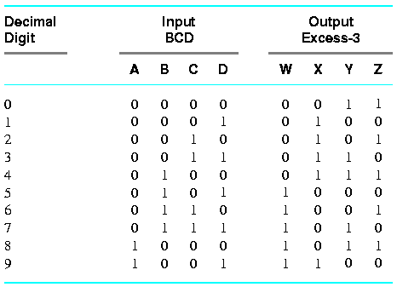
Example
Code converter
  A circuit that translates one binary code to another
Example 3-2: BCD to Excess-3 Code Converter
  Excess-3 code: decimal code + 3
  BCD inputs 1010 to 1111 are don’t care conditions

Slide 7
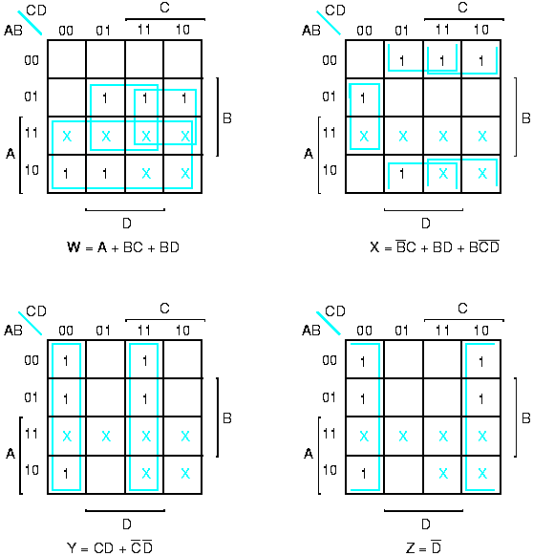
Example

Slide 8
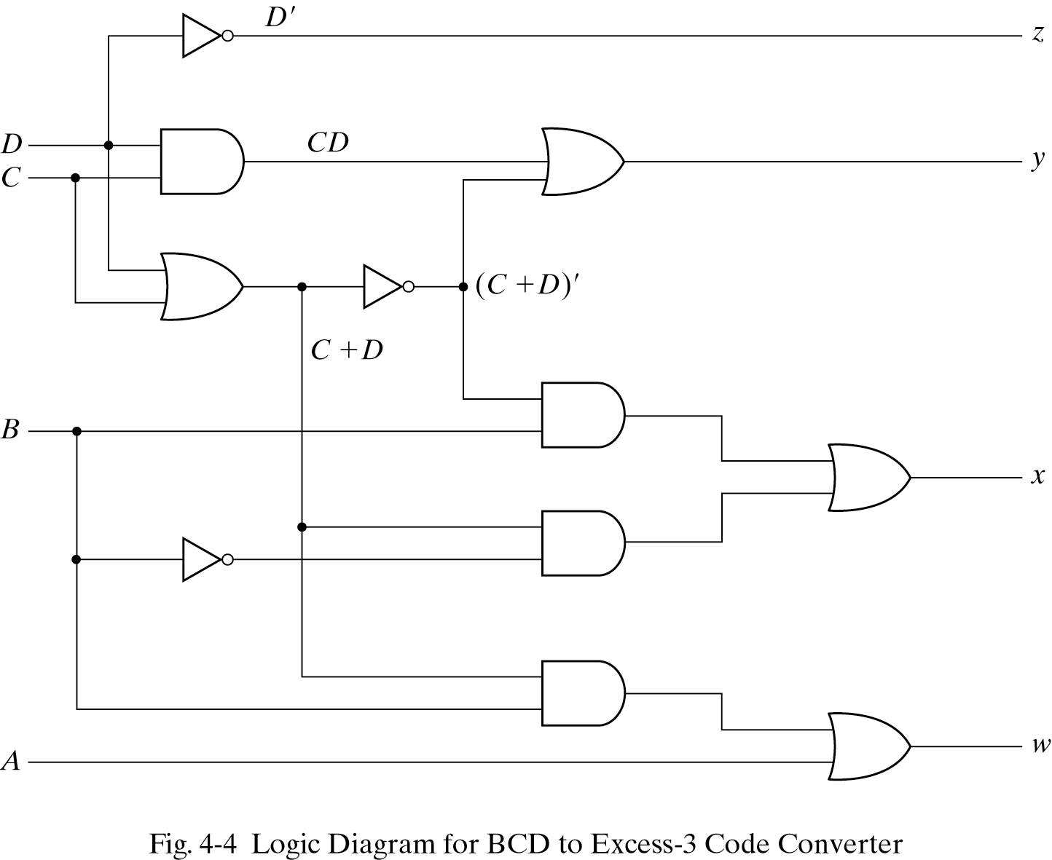
Example
  Two-level AND-OR implementation for the circuit can be obtained directly from the Boolean expressions.
    Common product terms can be shared for multiple-output circuits.
  However, there are several possibilities for the implementation. The following shows the implementation with 3 levels of gates.
  W = A + BC + BD = A + B(C + D)
  X = B'C + B'D + BC'D' = B'(C + D) + BC'D'
  Y = CD + C'D' = CD + (C + D)'
  Z = D'

Slide 9
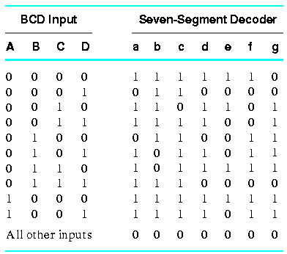
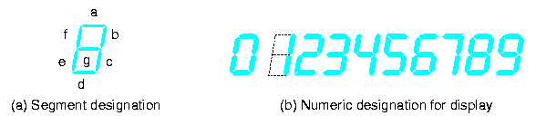
Example 2
Example 3-3: BCD-to-Seven-Segment Decoder
  Accept a BCD code and generate the appropriate outputs in the LED (light-emitting diodes)
  Inputs: BCD code (0000 ~ 1001)
  Outputs:

Slide 10
BCD-to-Excess-3 Code Converter
Draw Karnaugh Maps
Boolean functions for 7 outputs
  A = A’C + A’BD + B’C’D’ + AB’C’
  B = A’B’ + A’C’D’ + A’CD + AB’C’
  C = A’B + A’D + B’C’D’ + AB’C’
  D = A’CD’ + A’B’C + B’C’D’ + AB’C’ + A’BC’D
  E = A’CD’ + B’C’D’
  F = A’BC’ + A’C’D’ + A’BD’ + AB’C’
  G = A’CD’ + A’B’C + A’BC’ + AB’C’
Common product terms
  AND gates can be shared by several outputs
    27 product terms, but only 15 AND gates
  Simplification of multiple output functions involves finding identical implicants from two or more functions to reduce the total number of gates

Slide 11
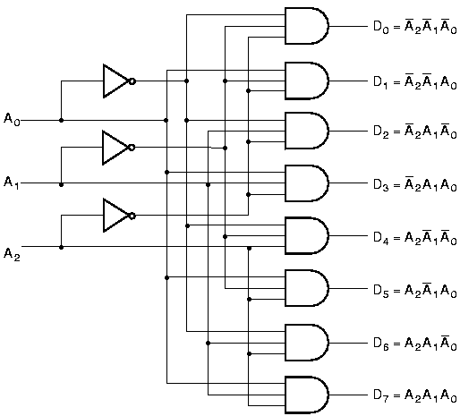
Decoders
Decoders
  Convert binary code of n bits to a maximum of 2^{n} unique outputs
    A binary code of n bits represents 2^{n} distinct elements
n-to-m-line decoders (m < 2^{n})
  Generate 2^{n} (or fewer) minterms of n input variables
  3-to-8-line decoder
    3 inputs & 8 outputs

Slide 12
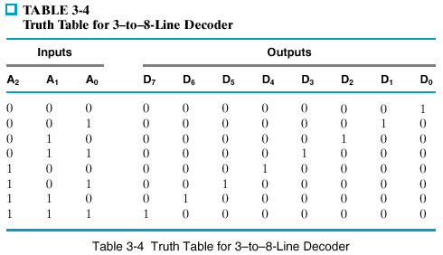
3-to-8 Line Decoders

Slide 13
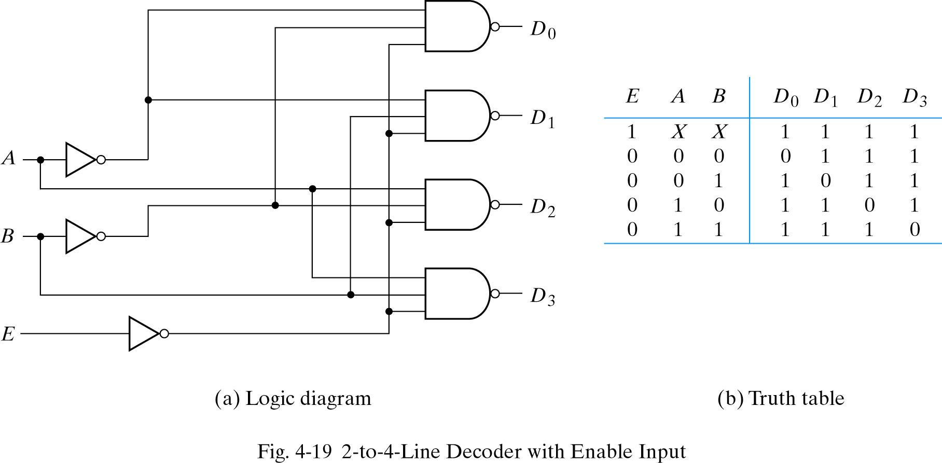
2-to-4 Line Decoders with NAND
Decoders constructed with NAND gates & enable input
  NAND gate is usually preferred since in typical logic families, AND is implemented by a NAND followed by a NOT gate
  The decoder is enabled when E is equal to 0

Slide 14
Demultiplexer
Demultiplexer
  A circuit that receives information from a single line and directs it to one of 2^{n} possible output lines
  Perform the inverse operation of a multiplexer
  The selection of a specified output is controlled by n selection lines
Example
  The previous 2-to-4 line decoder with enable input can function as 1-to-4 line demultiplexer
    E is taken as a data input line and A and B are taken as the selection inputs
  A decoder with an enable input is referred to as a decoder/demultiplexer since decoder and demultiplexer operations are obtained from the same circuit

Slide 15
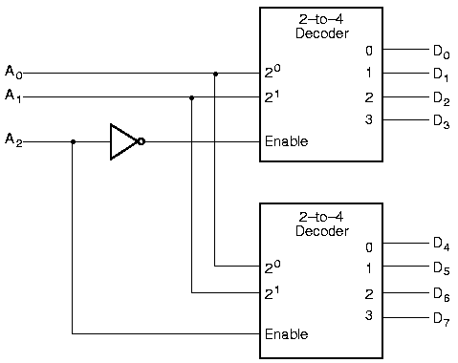
Decoder Expansion
Decoder expansion
  Decoders with enable inputs can be connected together to form a larger decoder
  3-to-8-line decoder constructed from two 2-to-4-line decoders
    The MSB is connected to the enable inputs
    if A₂=0, upper is enabled; if A₂=1, lower is enabled.

Slide 16
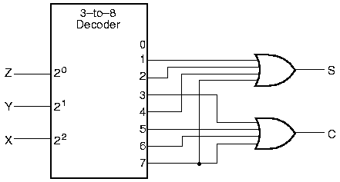
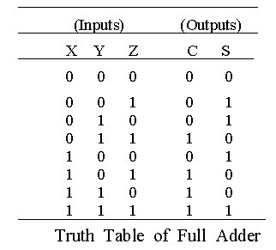
Comb. Circuit Design with Decoders
Combinational circuit implementation with decoders
  A decoder provide 2^{n} minterms of n input variables
  Since any Boolean function can be expressed as a sum of minterms, one can use a decoder and external OR gates to implement any combinational function.
Example 3.4: a binary adder
  S(X,Y,Z) = Σ m(1,2,4,7); C(X,Y,Z) = Σ m(3,5,6,7)

Slide 17
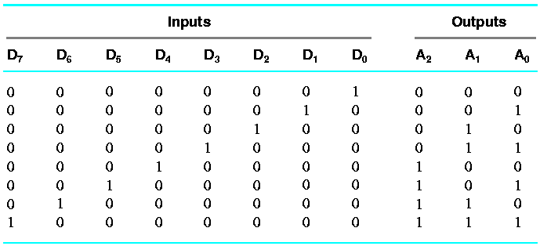
Encoders
Perform the inverse operation of a decoder
  2^{n} (or less) input lines and n output lines
  Can be implemented with 3 OR gates
      A₀ = D₁ + D₃ + D₅ + D₇;
      A₁ = D₂ + D₃ + D₆ + D₇;
      A₂ = D₄ + D₅ + D₆ + D₇;
  However, only one input can be active at any given time
    If more than 2 inputs are active  undefined ! priority for inputs
    If all the inputs are 0  The output is the same as when D0 is equal to 1 ! Provide one more output to indicate that at least one input is equal to 1

Slide 18
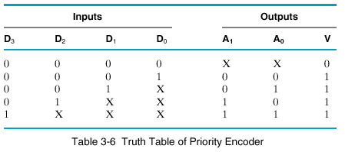
Priority Encoder
Priority encoder
  2 or more inputs are equal to 1 at the same time, an input with the highest priority will take precedence

Slide 19
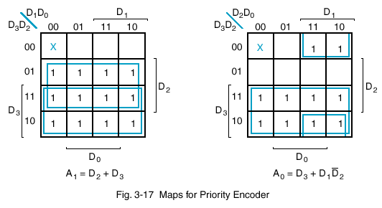
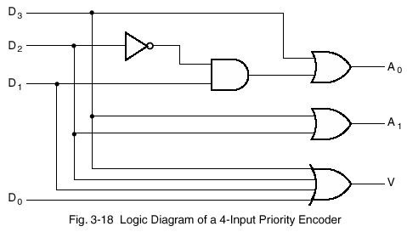
Priority Encoder

Slide 20
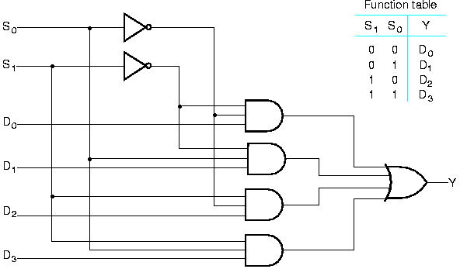
Multiplexers
Multiplexer (MUX)
  Select one of many input lines and direct it to a single output line
  Normally, n selection inputs determine one of the 2^{n} input lines
  4-to-1-line multiplexer
  2^{n}-to-1-line multiplexer is constructed from n-to-2^{n} decoder by adding 2^{n} input lines and an external OR gate

Slide 21
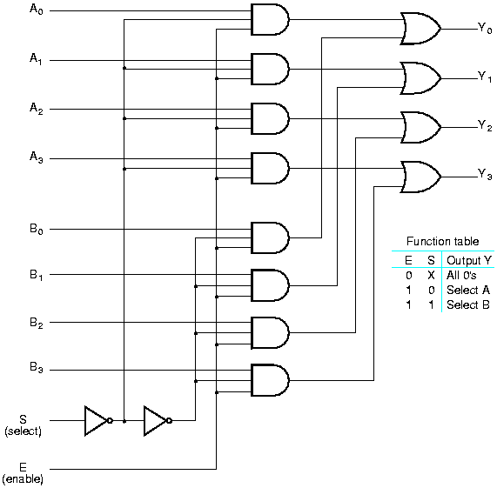
Quadruple 2-to-1 Line Multiplexer

Slide 22
Comb. Circuit Design with MUX
Combinational Circuit Implementation
  We learned that a decoder can be used to implement Boolean functions by employing external OR gates.
  Multiplexer is essentially a decoder that includes the OR gate
  The minterms of a function are generated in a multiplexer by the circuit associated with the selection inputs
We can implement a Boolean function of n variables with a multiplexer with n-1 selection inputs
  The first (n-1) variables are connected to the selection inputs
  The remaining 1 variable is used for the data inputs in the form of Z, Z’, 0, or 1
  For each combination of the selection variables, we evaluate the output as a function of the last variable. This function can be 0, 1, Z, or Z’.

Slide 23
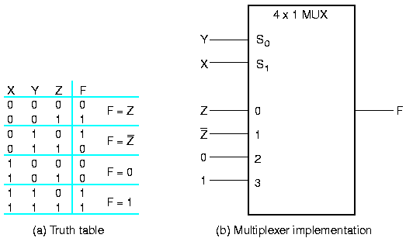
Example 1
Example: F(X, Y, Z) = m(1, 2, 6, 7)
  Implemented with a 4-to-1 line multiplexer
  Any Boolean function of n variables can be implemented with a multiplexer with n-1 selection inputs and 2^{n-1} data inputs

Slide 24
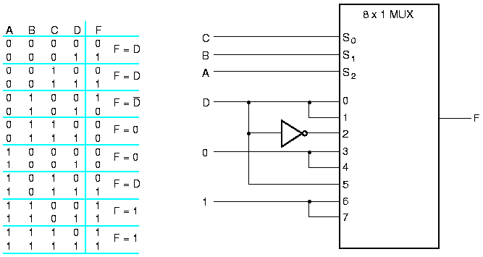
Example 2
  F(A,B,C,D) = Σ m(1,3,4,11,12,13,14,15)

Slide 25
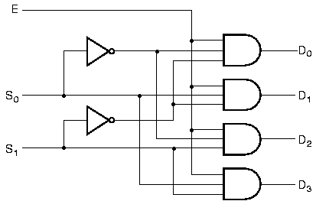

Demultiplexers
Demultiplexer (DEMUX)
  Perform the inverse operation of a multiplexer
  Receives information from a single line and transmits it to one of 2^{n} possible output lines
  n selection inputs select the specified output
1-to-4-line demultiplexer
  The input E has a path to all 4 outputs, selected by two selection lines S1 and S0
  Identical to a 2-to-4 line decoder with enable input
  A decoder with enable input is referred to as decoder / demultiplexer

Slide 26
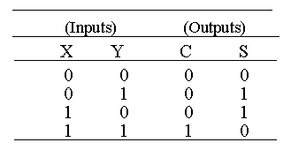
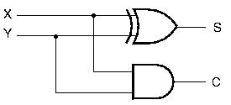
Binary Adders
Arithmetic circuit
  A combinational circuit that performs arithmetic operations such as addition, subtraction, multiplication, and division
Half adder (HA)
  Addition of 2 1-bit inputs
  2 inputs (X, Y) and 2 outputs (S: sum, C: carry)
        S = X'Y + XY' = X ⊕ Y
  C = XY

Slide 27
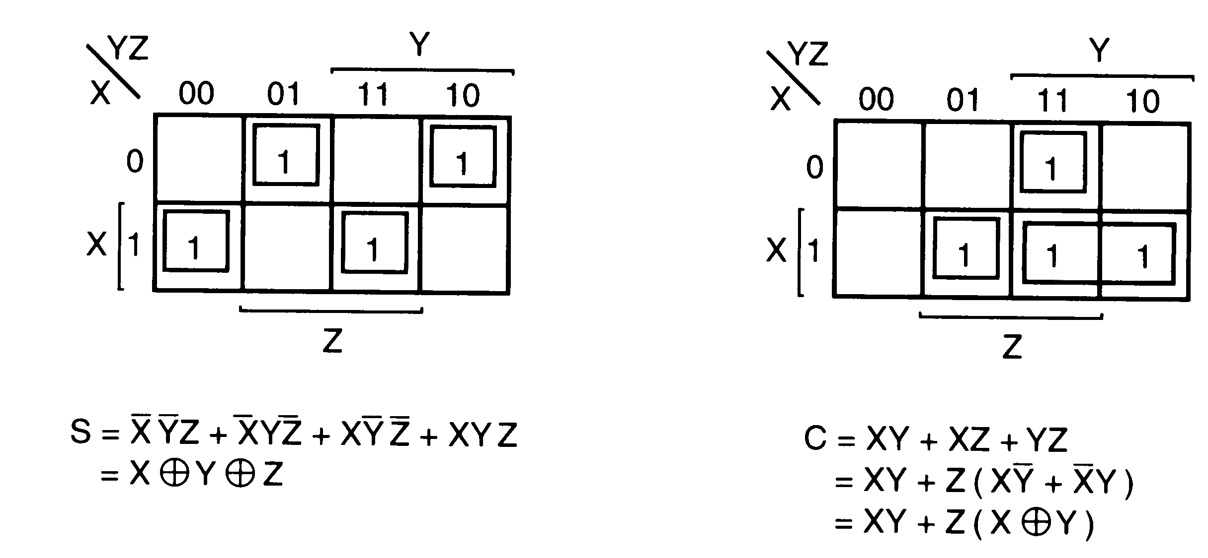
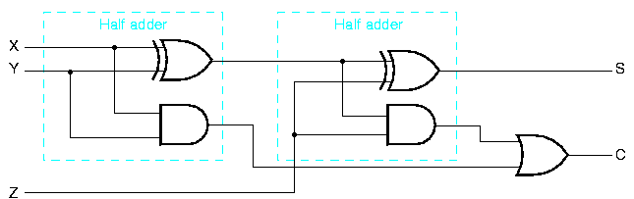
Full Adder
Addition of 3 inputs (X, Y, Z: input carry)
Require 2 half adders

Slide 28
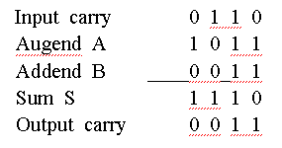
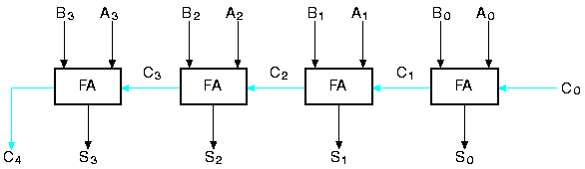
n bit Binary Adders
Binary Ripple Carry Adder (parallel adder)
  Use n FAs in parallel to produce the arithmetic sum of two n-bit binary numbers
4-bit parallel adder
  A = 1011, B = 0011

Slide 29

Carry Lookahead Adder
Motivation
  The ripple carry adder has a long circuit delay
    The FAs are connected in cascade, creating a carry path from the LSB to the MSB
    The longest delay is 2 n + 2 gate delay
      A_{i} ⊕ B_{i} (0 ≤ I ≤ 3) are computed in parallel before it is ANDed with Ci
      Example: For 32b adder, 66 gate delays => unacceptable
Carry Lookahead Adder
  Reduced delay at the price of complex hardware
    Convert the carry logic over fixed group of bits to 2-level logic

Slide 30
Carry Lookahead Adder
4 bit CLA consists of 2 parts
  Partial full adder (PFA)
    FA without the carry propagation path
    Generates 2 outputs
      P_{i} = A_{i} ⊕ B_{i} (propagate function)
      G_{i} = A_{i}B_{i} (generate function)
  Carry path
    Implement C₁, C₂, C₃, C₄ in two-level logic
    In general, C_{i+1} = A_{i}B_{i} + C_{i} (A_{i} ⊕ B_{i}) = G_{i} + P_{i}C_{i}
      C₁ = A₀B₀ + C₀ (A₀ ⊕ B₀) = G₀ + P₀C₀
      C₂ = A₁B₁ + C₁ (A₁ ⊕ B₁) = G₁ + P₁C₁ = G₁ + P₁(G₀ + P₀C₀) = G₁ + P₁G₀ + P₁P₀C₀
      C₃ = G₂ + P₂C₂ = G₂ + P₂(G₁ + P₁G₀ + P₁P₀C₀) = G₂ + P₂G₁ + P₂P₁G₀ + P₂P₁P₀C₀
      C₄ = G₃ + P₃C₃ = G₃ + P₃G₂ + P₃P₂G₁ + P₃P₂P₁G₀ + P₃P₂P₁P₀C₀ = G₃₋₀ + P₃₋₀C₀
    Also, generate group propagate and group generate function outputs
      P₃₋₀ = P₃P₂P₁P₀
      G₃₋₀ = G₃ + P₃G₂ + P₃P₂G₁ + P₃P₂P₁G₀

Slide 31
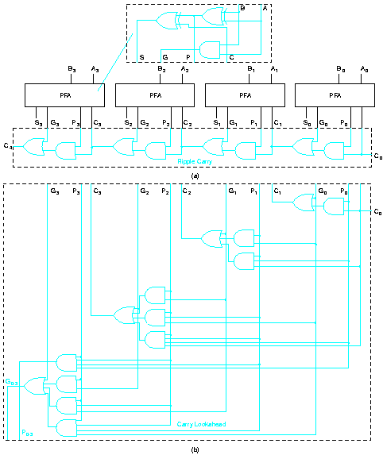
4 bit CLA
B₃₋₀
A₃₋₀
4-bit CLA
S₃₋₀
G₃₋₀
P₃₋₀

Slide 32
16-bit CLA
B₁₅₋₁₂
A₁₅₋₁₂
B₁₁₋₈
A₁₁₋₈
B₇₋₄
A₇₋₄
B₃₋₀
A₃₋₀
4-bit CLA
4-bit CLA
4-bit CLA
4-bit CLA
S₁₅₋₁₂
G₁₅₋₁₂
P₁₅₋₁₂
S₁₁₋₈
G₁₁₋₈
P₁₁₋₈
S₇₋₄
G₇₋₄
P₇₋₄
S₃₋₀
G₃₋₀
P₃₋₀
C₁₂
C₈
C₄
Carry Path
C₁₆
or
P₁₅₋₀ , G₁₅₋₀
C₀

Slide 33
CLA Delay Analysis
4 bit adders
  4b CLA: 6 gate delays
  4b RCA: 2n + 2 = 10 gate delays
In general, for the N-bit CLA with L lookahead levels
  L = log₄N
  The longest path delay = 4L + 2
  Example: 64-bit adders
    64b RCA: 2 * 64 + 2 = 130 gate delays
    64b CLA: 4 * log₄N + 2 = 4 * 3 + 2 = 14 gate delays

Slide 34
Binary Subtractor
Binary subtractor
  The subtraction A – B can be done by taking the 2’s complement of B and adding it to A
  The 2’s complement can be obtained by taking the 1’s complement and adding one to the LSB
Binary adder subtractor
  The addition and the subtraction can be combined into one circuit with one common binary adder by adding an XOR gate

Slide 35
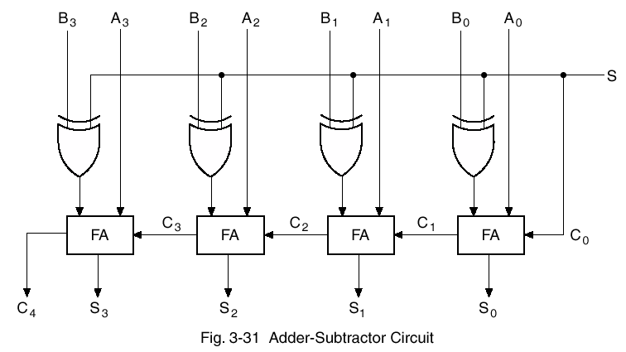
Binary Adder-Subtractor
If S = 0, the circuit is an adder. Otherwise, it is a subtractor.

Slide 36
Overflow
Overflow
  Occurs when the (addition/subtraction) result of two n-bit numbers requires n+1 bits
Example
  8-bit binary number in 2’s complement form can represent –128 to 127.
  Consider the following example:
  Carries: 0 1 Carries:1 0
  +70 0 1000110 -70 1 0111010
  +80 0 1010000 -80 1 0110000
  +150 1 0010110 -150 0 1101010
  The sign bit of the 8-bit result has been changed. However, if we consider the carry out as the sign bit, the 9-bit answer is correct.
Overflow condition
  Can be detected by observing the carry into the sign bit position and the carry out of the sign bit position.
  If these two carries are not equal, then an overflow occurs.

Slide 37
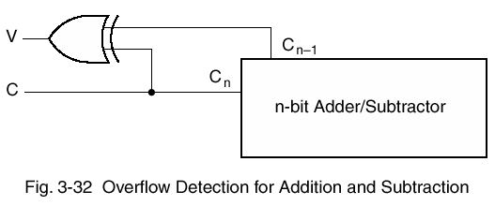
Overflow Detection

Slide 38
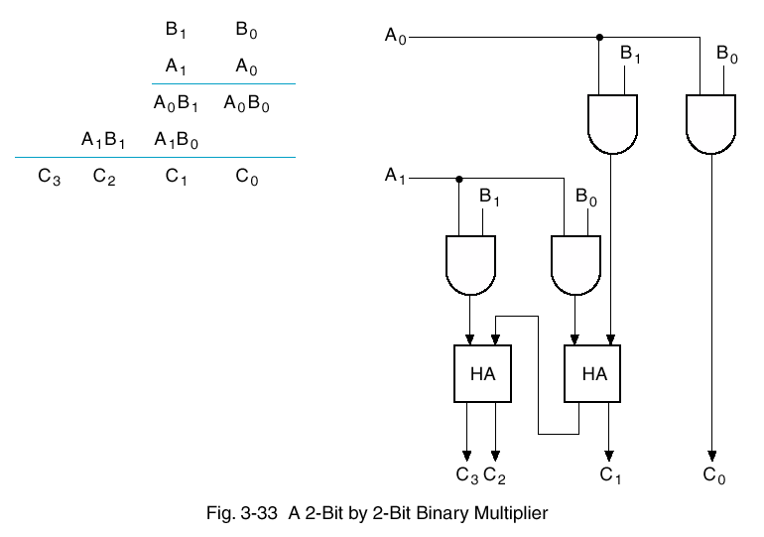
Binary Multipliers

Slide 39
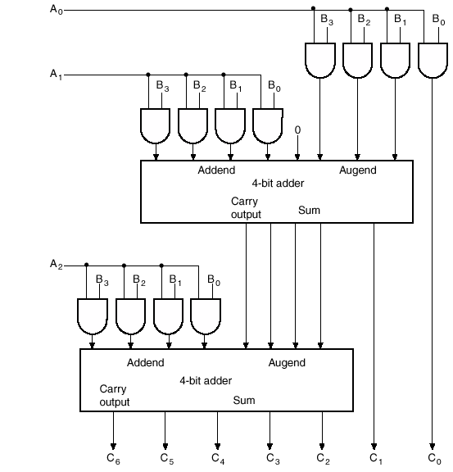
A 4b X 3b Binary Multiplier

Slide 40
BCD Addition
BCD addition procedure
  Add two BCD numbers as if they were two 4b binary numbers.
  Including the input carry, the range of the sum is 0 ~ 19(9+9+1).
  If the sum is less than or equal to 1001 (9), then the result is correct.
  If the sum is greater than 1001, we obtain an invalid BCD result. Correct the result by adding 0110 (6) to the binary sum.
Correction of the BCD addition
  Need to detect if the sum is between 1010 and 10011 (10 ~ 19).
  10000 ~ 10011 (16 ~ 19) can be detected by checking the carry out from the binary adder.
  1010 ~ 1111 (10 ~ 15) can be detected by checking a 1 in the MSB and a 1 in the 2nd or 3rd significant position.

Slide 41
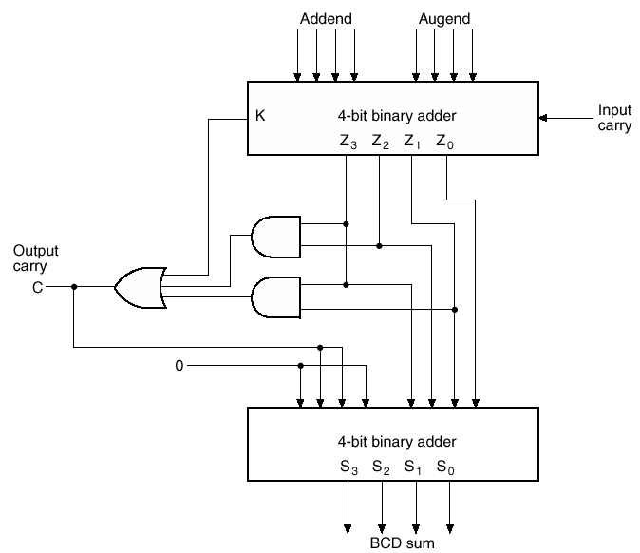
BCD Adder

Slide 42
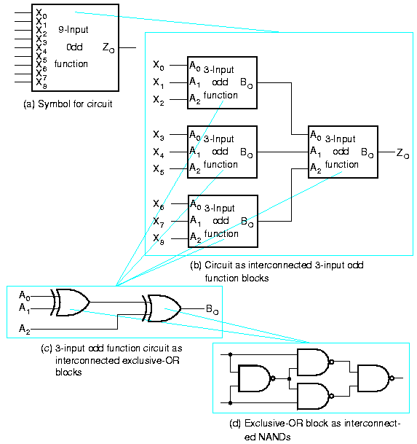
Design Hierarchy
Design hierarchy
  A single VLSI chip such as general purpose microprocessor may contain several million gates
   Approach divide & conquer  The circuit is broken up into pieces (blocks)
  A circuit may be specified by a symbol showing inputs, outputs, & a description defining exactly how it operates

Slide 43
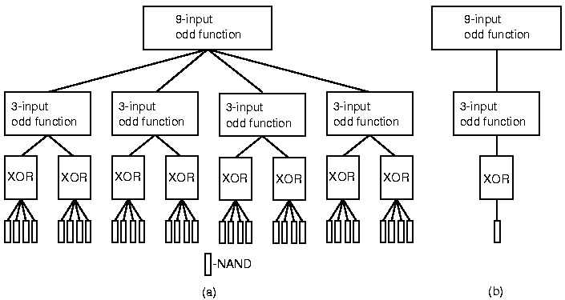
Design Hierarchy
Hierarchical design
  1. Reduce the complexity
    - Required to represent the schematic diagram of a circuit
  2. End at a set of "leaves" (consisting of NAND gates)
  3. Reuse of blocks

Slide 44
Homework IV
Read Chapter 5.
PROBLEMS
  4.1
  4.4
  4.8
  4.9
  4.13
  4.16
  4.20
  4.24
  4.28

